Slide 1
Better Understand Web Log Data with Real-Time Dashboards Fueled by AWS and Power BI
Noah Becker, Sharang Jindal, Alok Kumar,
Anuj Rewale, Patrick Seng, Pushkar Vengurlekar

Slide 2
Project Definition
Web log data contains an enormous amount of insights for organization across all corners of the business from IT to Marketing
These insights can be applied across industries and provide important information related to security, products, and changing consumer preferences
Our solution uses a combination of tools in a structured pipeline to collect web log data, filter and analyze data, and produce interpretable, informative dashboards
All done in real time in order to provide visibility to both IT and marketing functions within the organization

Slide 3

Problem Statement
Web log data from Iranian e-commerce company Zanbil
Data conforms to Apache standards
Zanbil hopes to gain a better understanding of how its users are interacting with the website
Additionally, as they continue to grow, the IT staff has concerns with their ability to effectively monitor online activity

Slide 4
Value
The value of a live web log analysis tool can be seen across an organization. Our design will support two critical components of any business:
IT Function:
Logging user activity across website
Monitoring site performance
Anomaly detection for potential attacks
Marketing Team:
Gain better understanding of customer profiles
Track changing consumer preferences

Slide 5
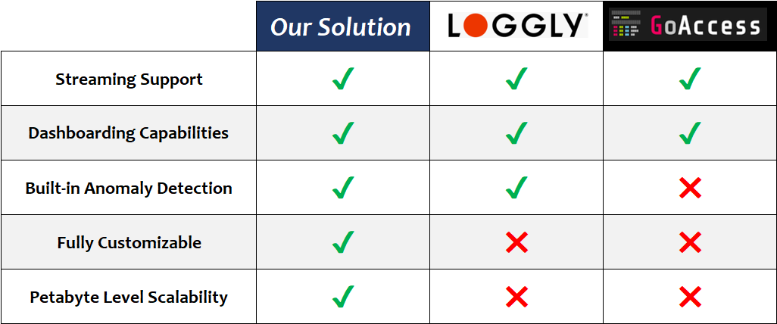
Competitive Landscape

Slide 6
Methods

Slide 7
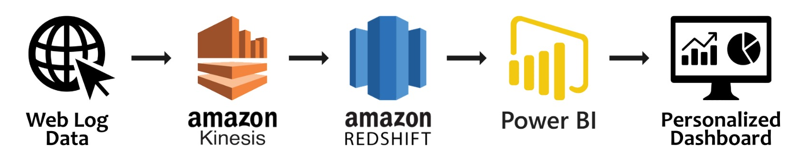
Solution Pipeline
Overall pipeline contains streaming collection, RDBMS based storage for the collected data, and platform for dashboarding and visualization
These components are optimized to work seamlessly with one another across AWS and Microsoft platforms

Slide 8

Amazon Kinesis
Amazon Kinesis provides real-time ingestion and processing capabilities for streaming data
Amazon Firehose is a powerful component of Kinesis that provides seamless integration with other AWS products including Redshift
Web log data uploaded into Kinesis streams in real time

Slide 9

Amazon Redshift
Amazon Redshift is a cloud based data warehousing platform that supports standard SQL and BI applications
Redshift can handle petabyte-scale using columnar storage
From Firehose, web log data is stored in Redshift where parallel querying capabilities are utilized to enable simultaneous visualizations

Slide 10

Microsoft Power BI
Microsoft Power BI is an analytics and visualization tool fully adaptable and customizable to meet specific business needs
Supports multiple dashboards facing various functional groups
Power BI is directly integrated with our Redshift databases via DirectQuery, allowing for dashboards updated in real time

Slide 11
Value

Slide 12
IT Dashboard Overview
The IT dashboard contains important information allowing the IT team to monitor activity with four distinct graphical components:
Website Load Analyzer - Tracks total traffic on website in real-time allowing IT team to proactively asses overload risks
Top IP Hits - Monitors hits for each IP address to track users that may have a suspicious amount of attempts in a certain timeframe
Erroneous Requests - Tracks status codes to determine where on the website users may be experiencing performance issues
Hits by Device Category - Displays most common device types used for accessing website allowing IT to optimize site for most common access platforms

Slide 13
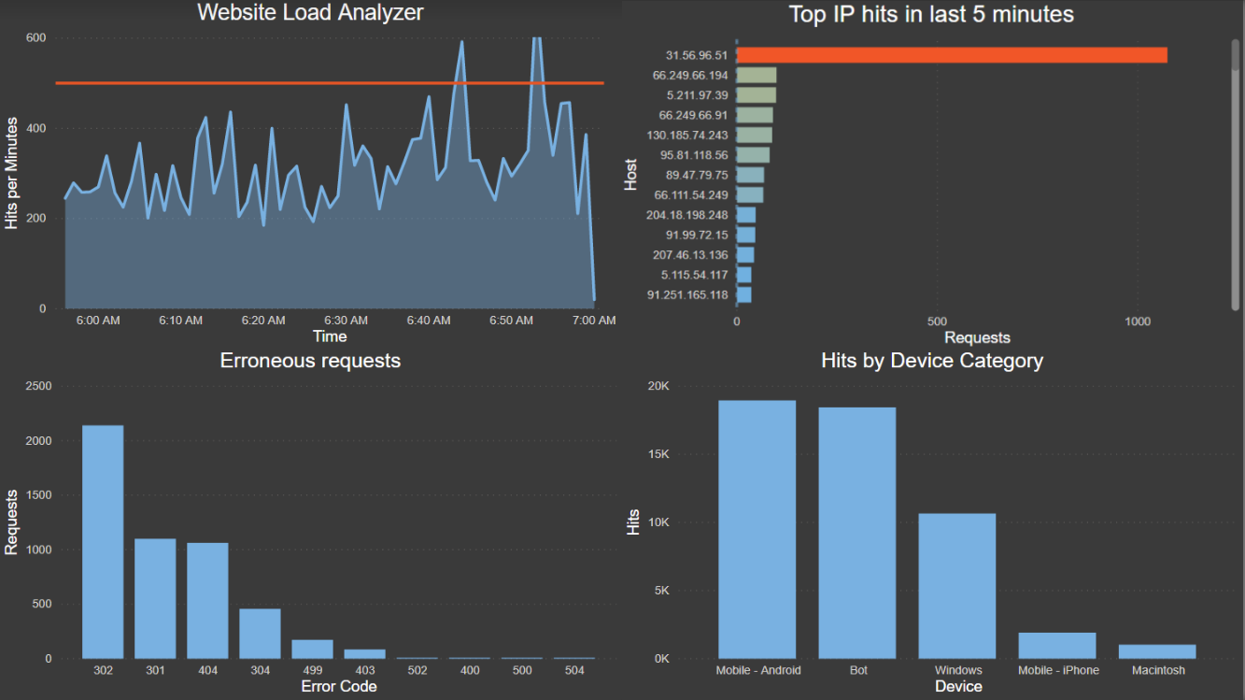
IT Dashboard

Slide 14
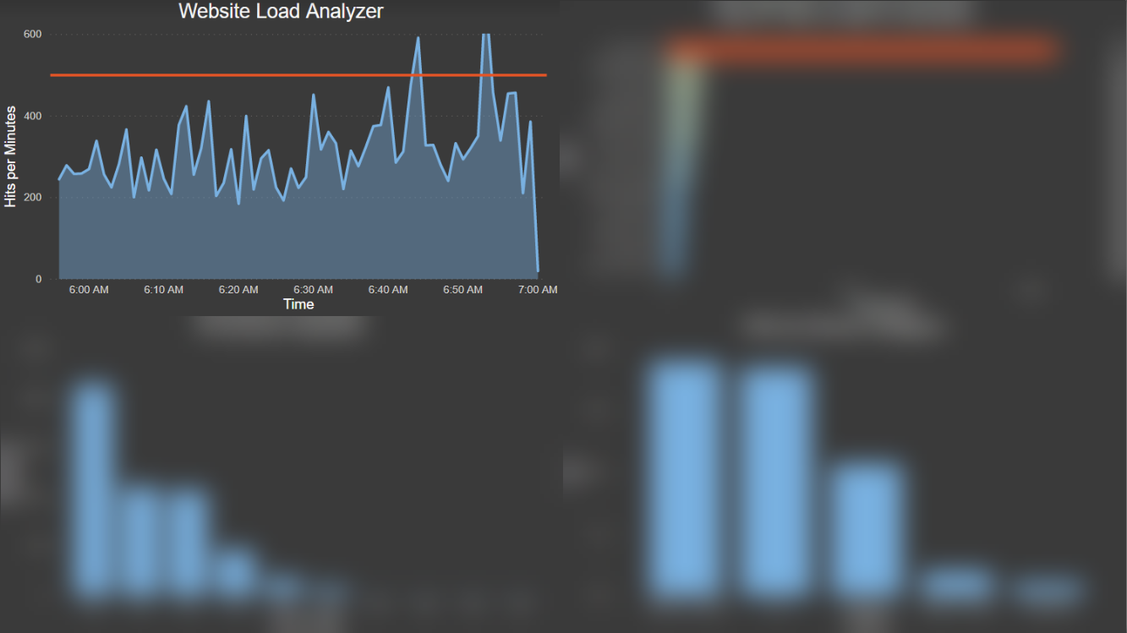
IT Dashboard

Slide 15
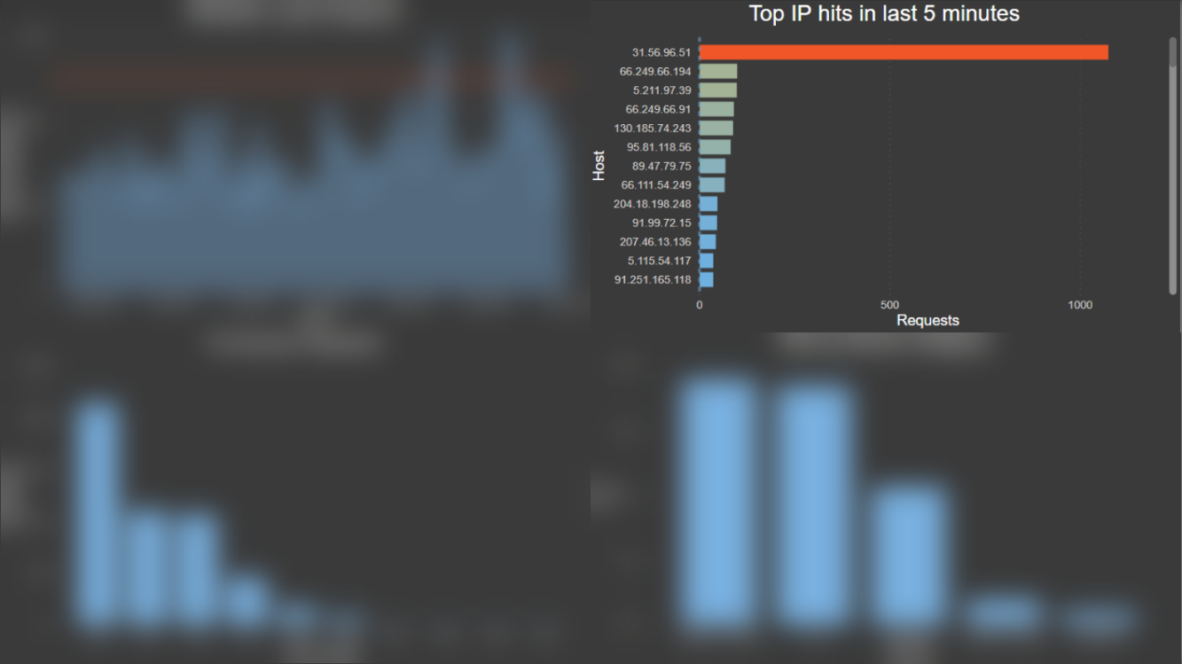
IT Dashboard

Slide 16
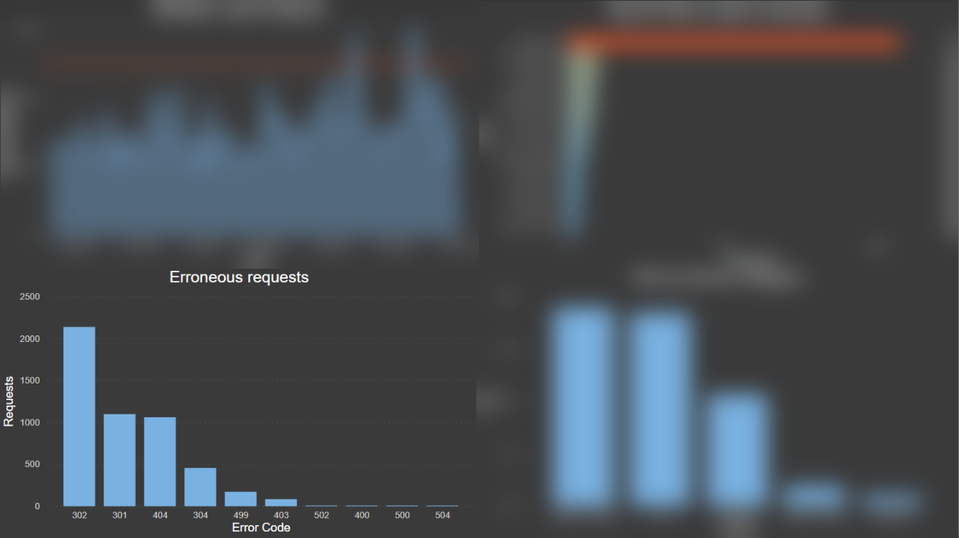
IT Dashboard

Slide 17

IT Dashboard

Slide 18
Marketing Dashboard Overview
The Marketing dashboard contains important information that enables the marketing team to track consumer attributes and preferences:
Location of Users - An interactive map of user access locations provides the business important information that can drive marketing decisions
Top Products - Most viewed products on the website can help the business understand consumer preferences beyond their purchases alone
Popularity by Device - Provides marketing team an overview of mobile vs. desktop access volumes which can help them make resource allocation and promotional decisions

Slide 19
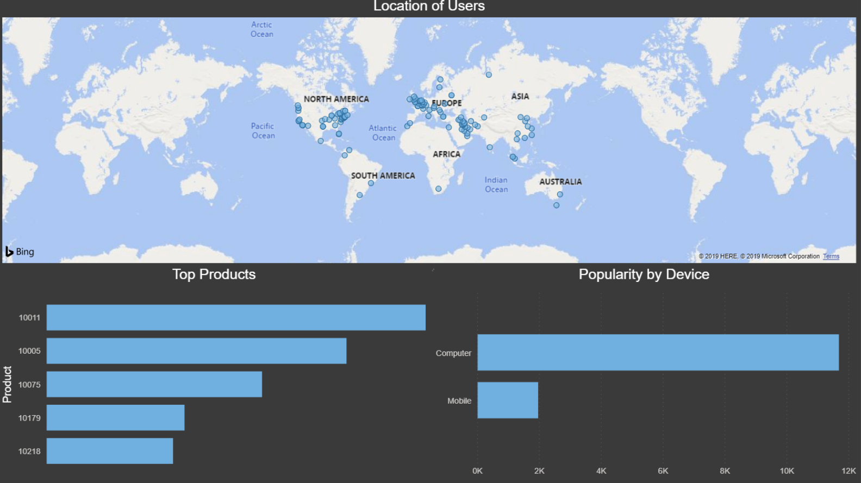
Marketing Dashboard Overview

Slide 20
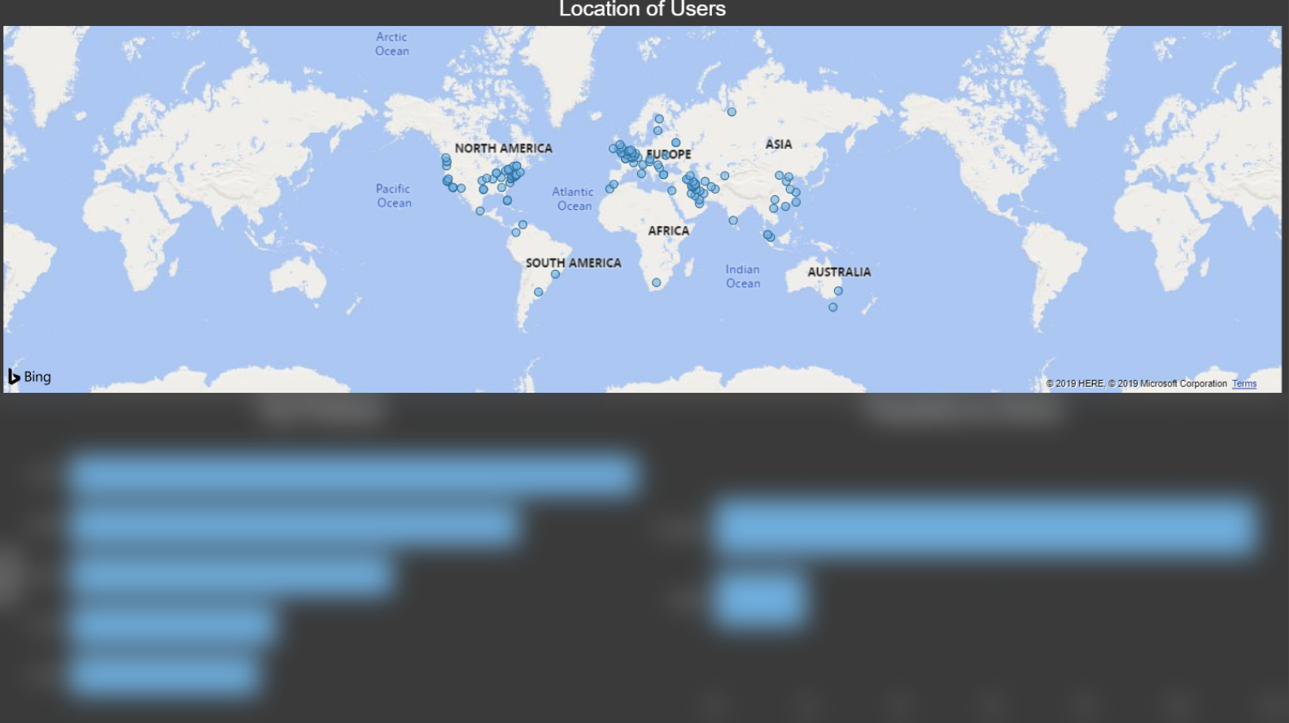
Marketing Dashboard Overview

Slide 21
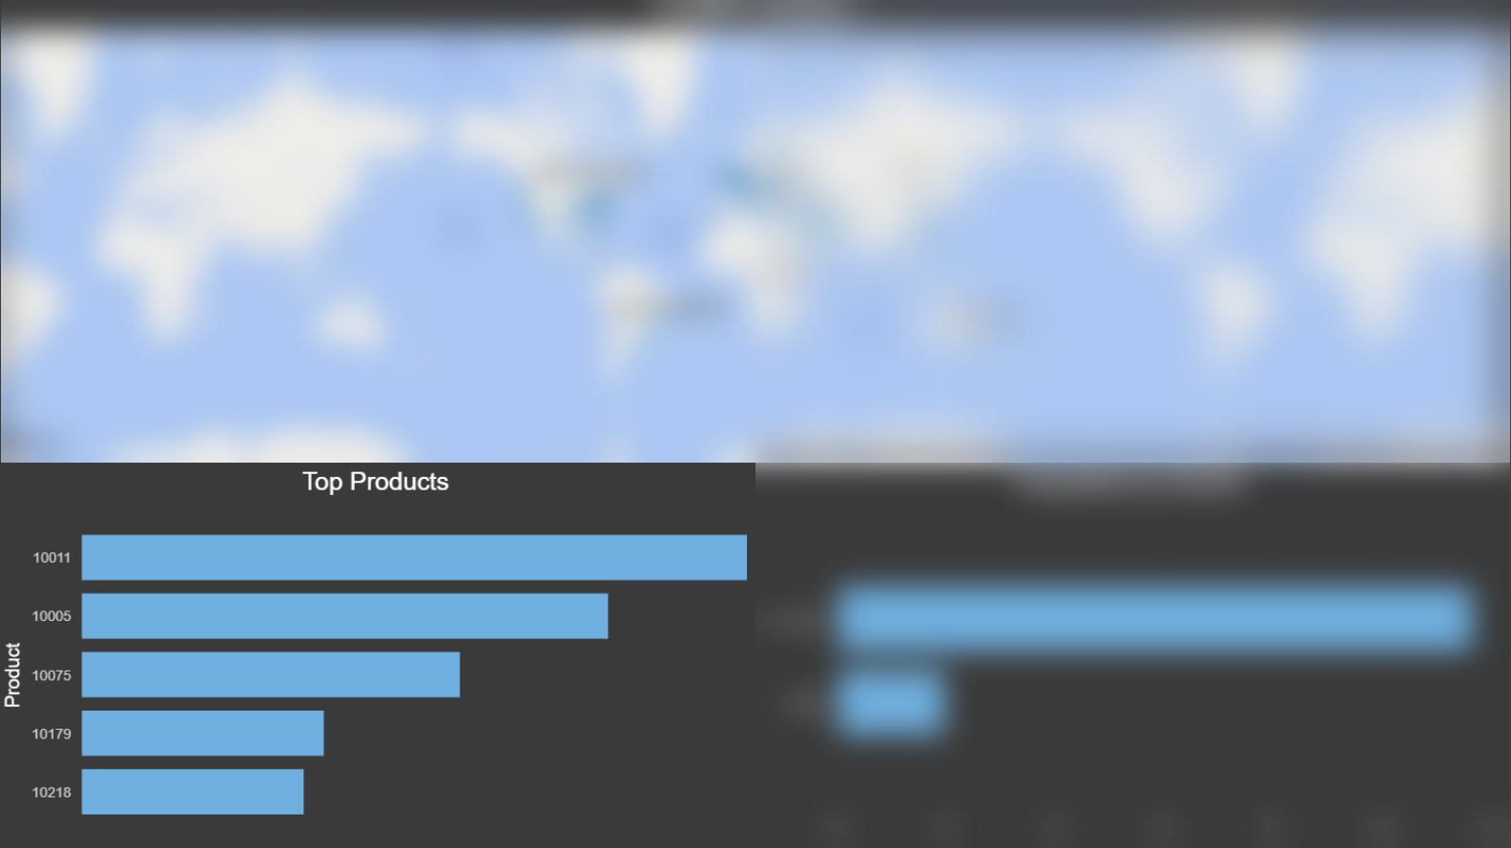
Marketing Dashboard Overview

Slide 22
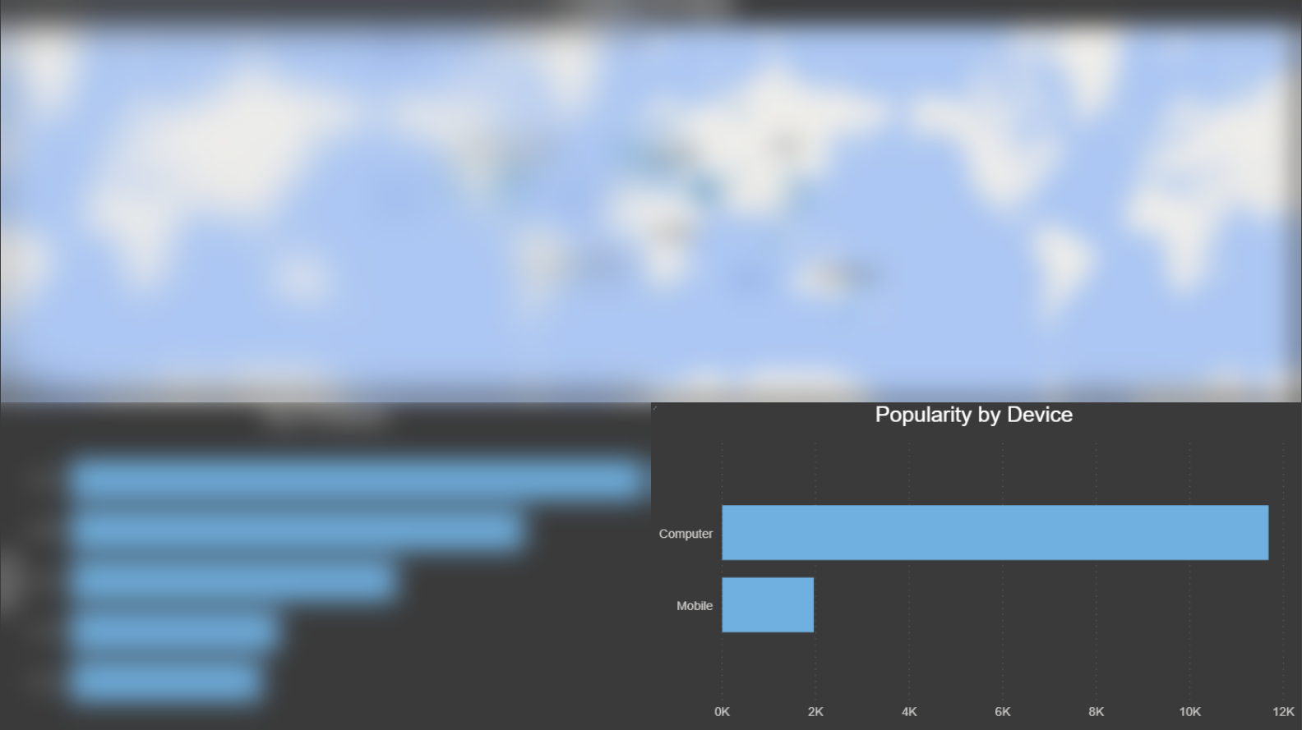
Marketing Dashboard Overview

Slide 23
Conclusion

Slide 24

Business Impact
Our solution helps the IT team monitor their website proactively, identifying potential performance issues and malicious behavior
Comprehensive dashboards enable the marketing team to better understand their customers’ changing behavior and preferences

Slide 25
Next Steps
Extend core functionality to other business segments such as finance, supply chain, and management.
Additional features:
Customizable trigger alerts based on specified conditions
Enhanced anomaly detection for other fraudulent behaviors
Clickstream flow visualizations to better identify customer pain points in the online experience

Slide 26
References
https://aws.amazon.com/kinesis/
https://aws.amazon.com/redshift/
https://powerbi.microsoft.com/en-us/
https://www.loggly.com/
https://goaccess.io/
https://dataverse.harvard.edu/dataset.xhtml?persistentId=doi:10.7910/DVN/3QBYB5

